Slide 1
What’s the Hazard?
Spot the hazards or failure to follow TDI Procedure
The following photos show one or more potential hazards and may or may not have mitigations in place.
Spot the hazards
What mitigations are in place?
What mitigations are missing/ needed?
Rev Nov2015

Slide 2
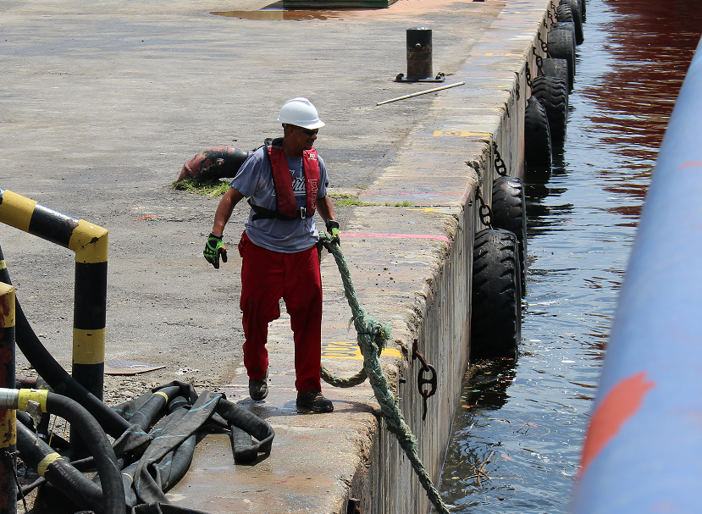
What’s the Hazard?

Slide 3
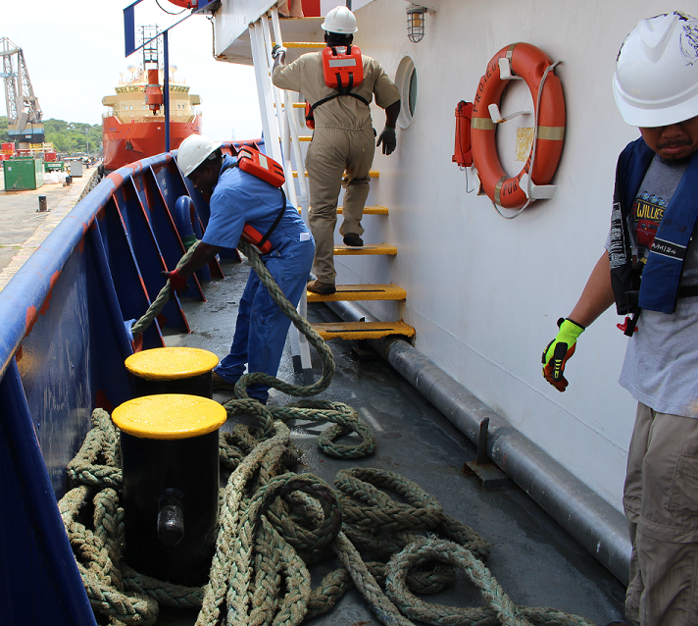
What’s the Hazard?

Slide 4
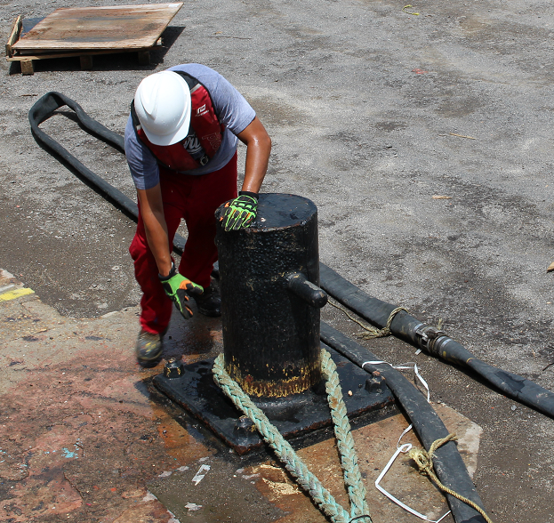
What’s the Hazard?

Slide 5
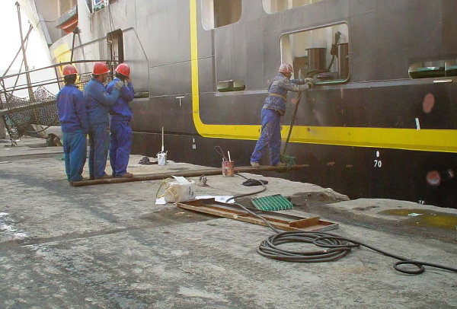
What’s the Hazard?

Slide 6
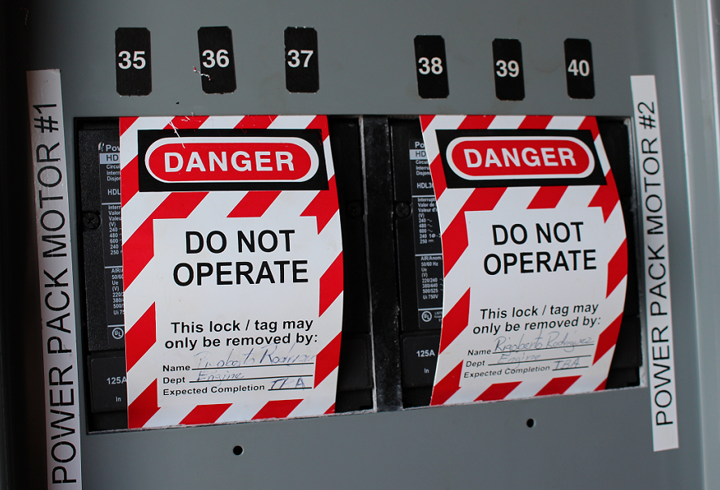
What’s the Hazard?

Slide 7
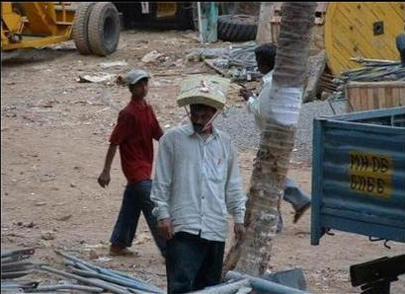
What’s the Hazard?

Slide 8
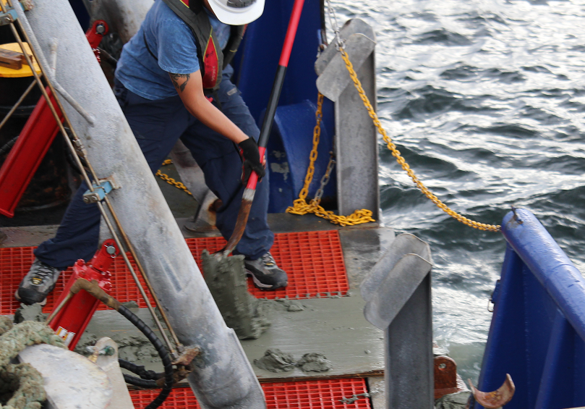
What’s the Hazard?

Slide 9
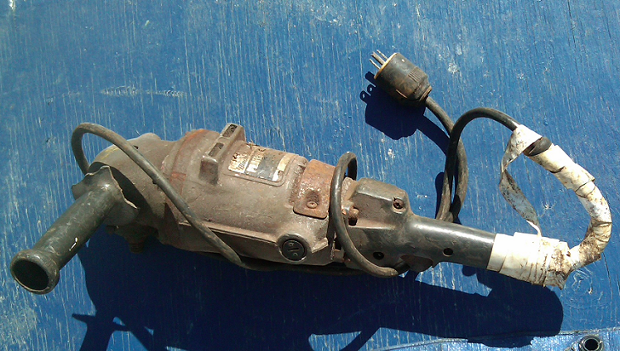
What’s the Hazard?

Slide 10
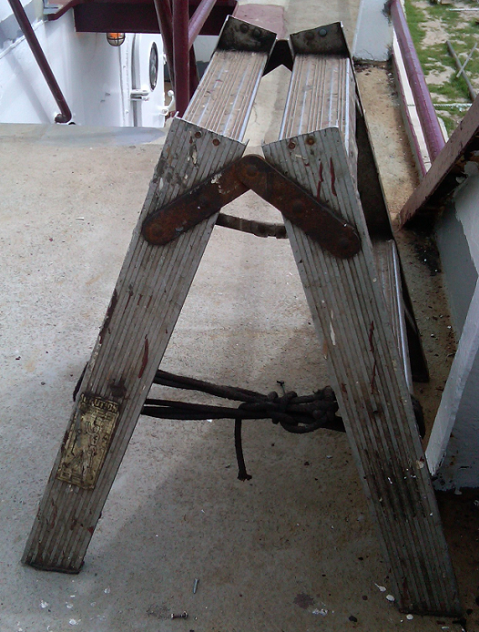
What’s the Hazard?
Homemade ladder. Full size ladder cut in half, bottom secured with rope.

Slide 11
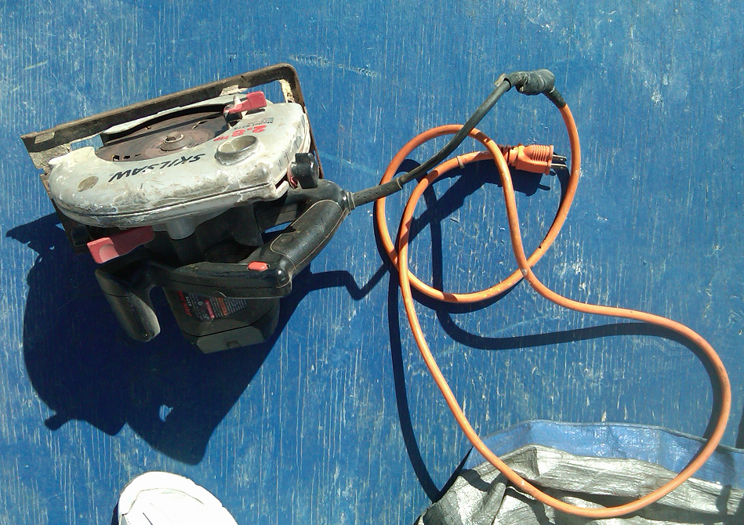
What’s the Hazard?

Slide 12
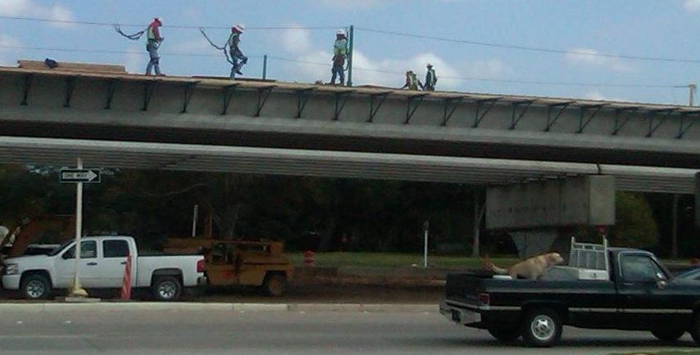
What’s the Hazard?

Slide 13
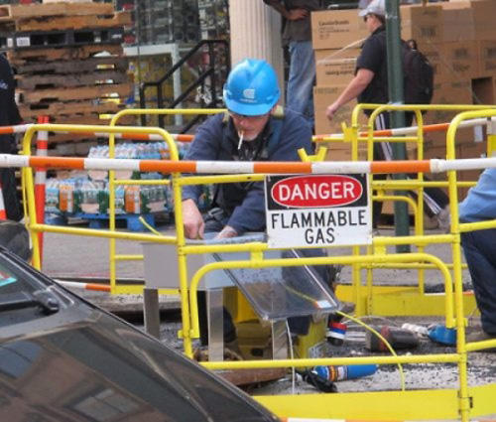
What’s the Hazard?

Slide 14
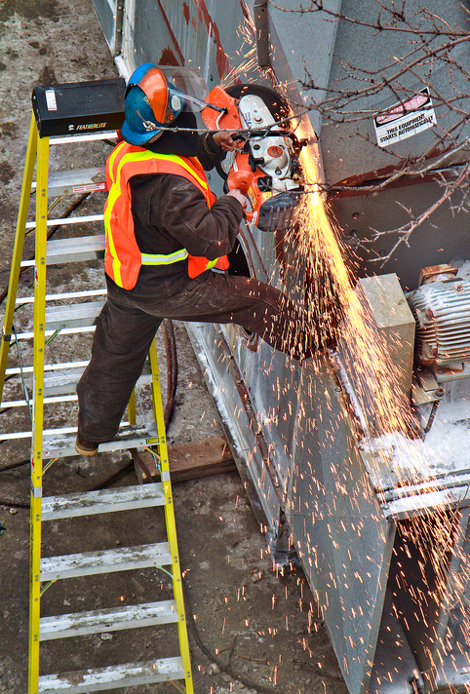
What’s the Hazard?

Slide 15

What’s the Hazard?

Slide 16
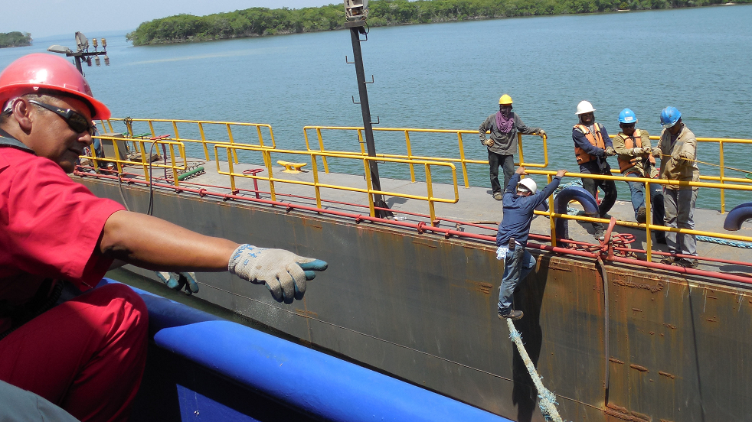
What’s the Hazard?

Slide 17
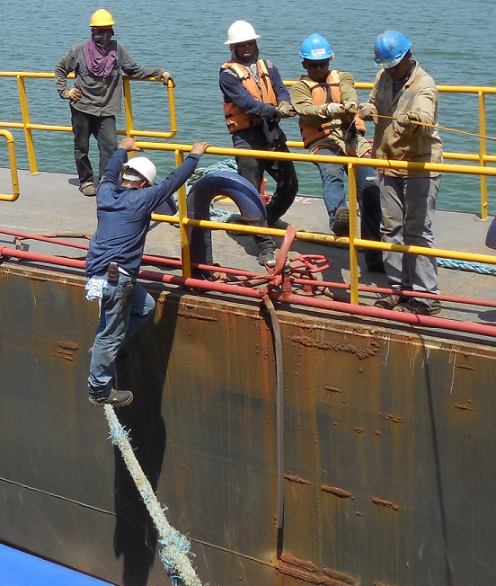
What’s the Hazard?

Slide 18
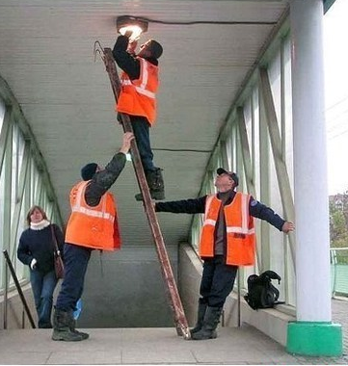
What’s the Hazard?

Slide 19
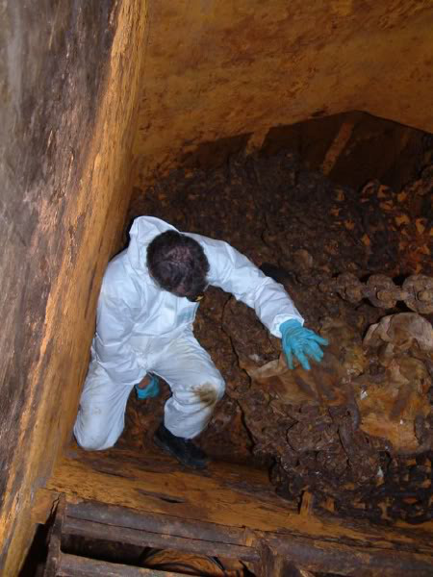
What’s the Hazard?
(man in chain locker of vessel)

Slide 20
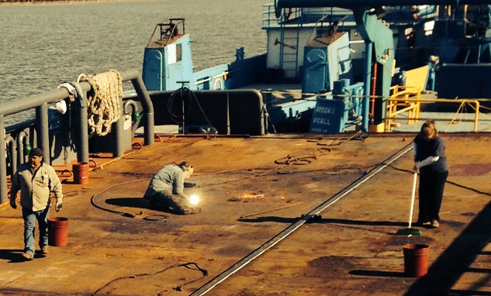
What’s the Hazard?

Slide 21
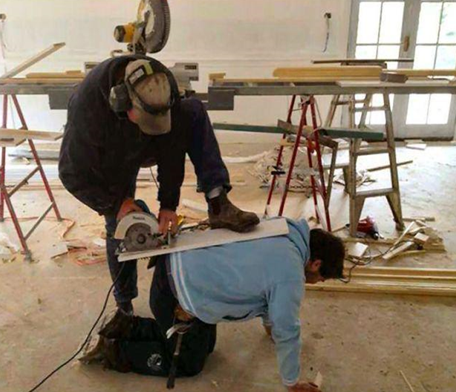
What’s the Hazard?

Slide 22
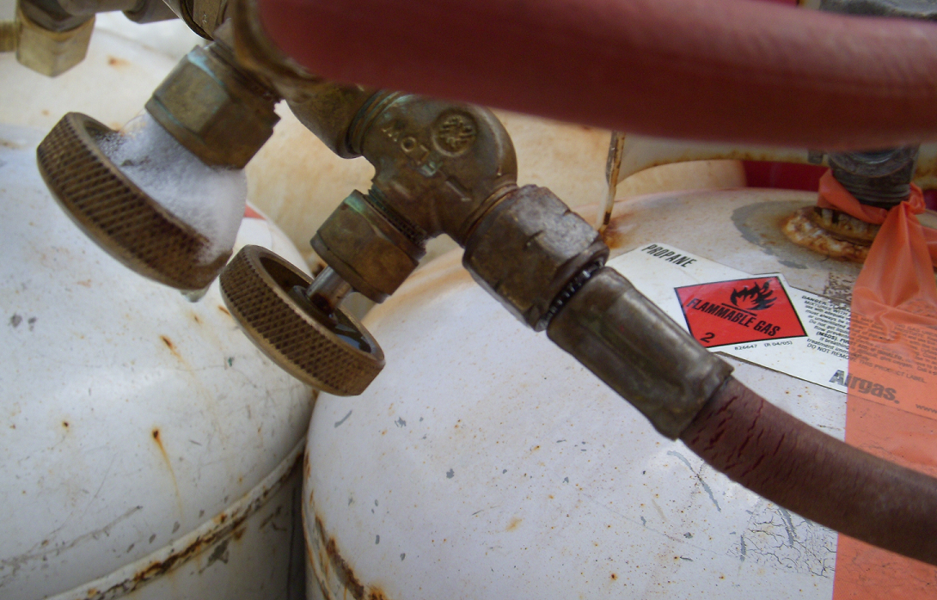
What’s the Hazard?

Slide 23
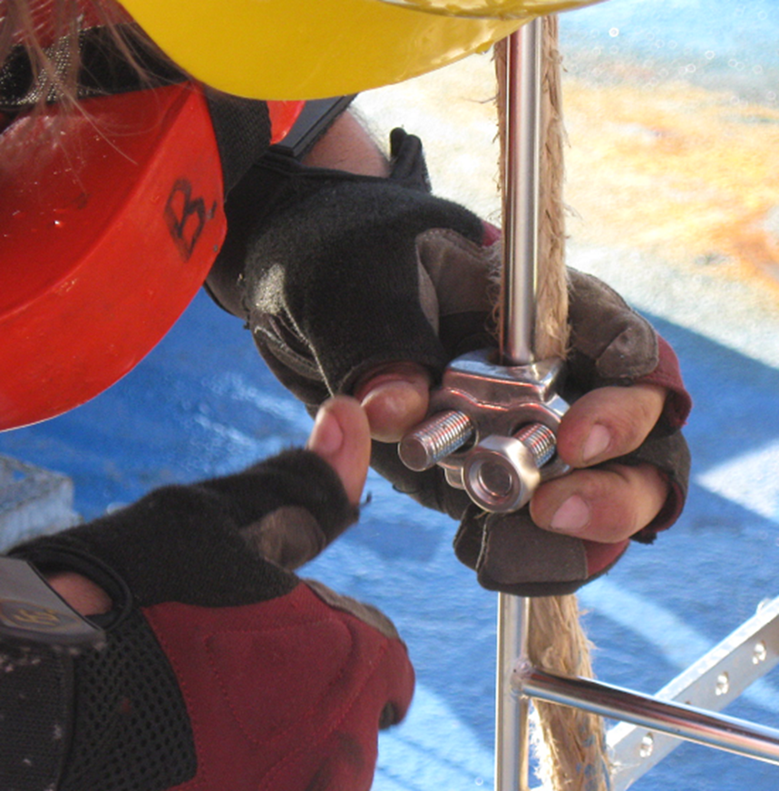
What’s wrong?

Slide 24
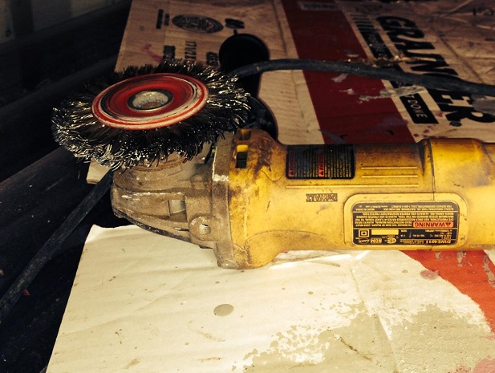
What’s wrong?

